Slide 1
Psychophysics: computational modelling of human perception

Slide 2


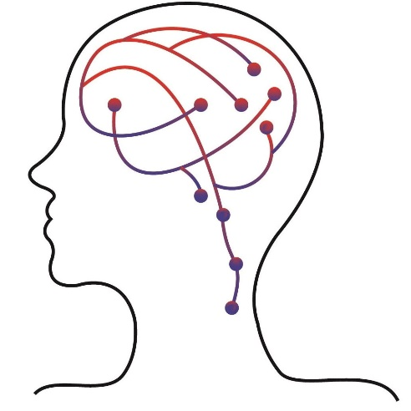
Who are we?
Arthur S. Courtin, PT, PhD
Postdoctoral fellow
arthur.courtin@cfin.au.dk
Jesper Fischer Ehmsen
Research assistant
jesperfischer@cfin.au.dk
Body, pain, and perception lab
Head: Francesca Fardo, PhD
bpp@cfin.au.dk
https://body-pain-perception-lab.github.io/

Slide 3
What do we do?
Topics:
Nociception
Thermosensation
Thermosensory illusions
Placebo hypoalgesia
Learning
Decision making
Techniques:
Behavioural tasks
fMRI
M/EEG
Pupillometry
Computational modelling
Psychophysics

Slide 4
Definition
“Psychophysics is the scientific study of the relationship between stimulus and sensation”
Gescheider, “Psychophysics: the fundamentals” third edition (1997)

Slide 5
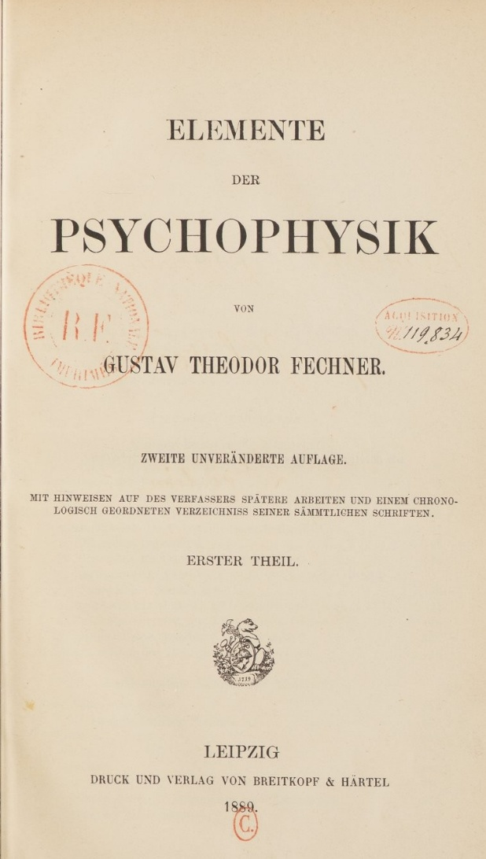
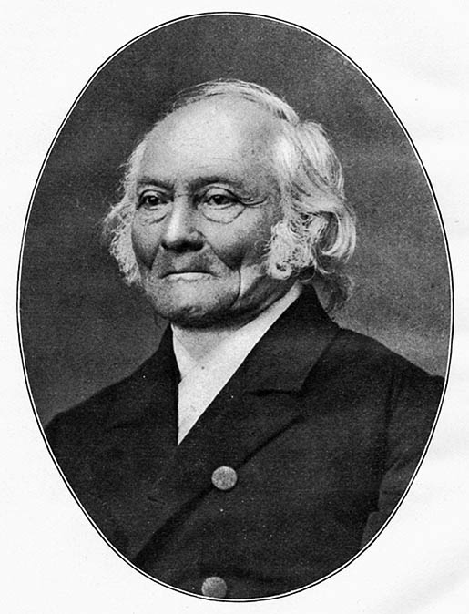
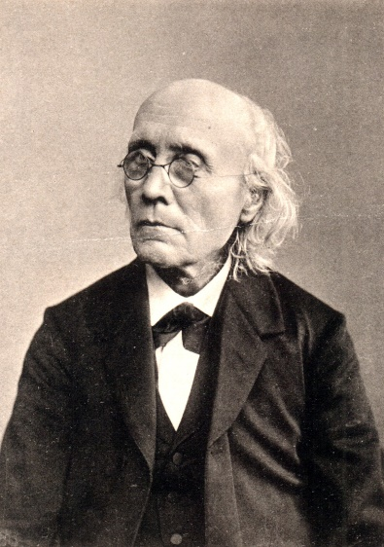
A long history
Ernst Weber
(1795-1878)
Gustav Fechner
(1801-1887)
1860

Slide 6
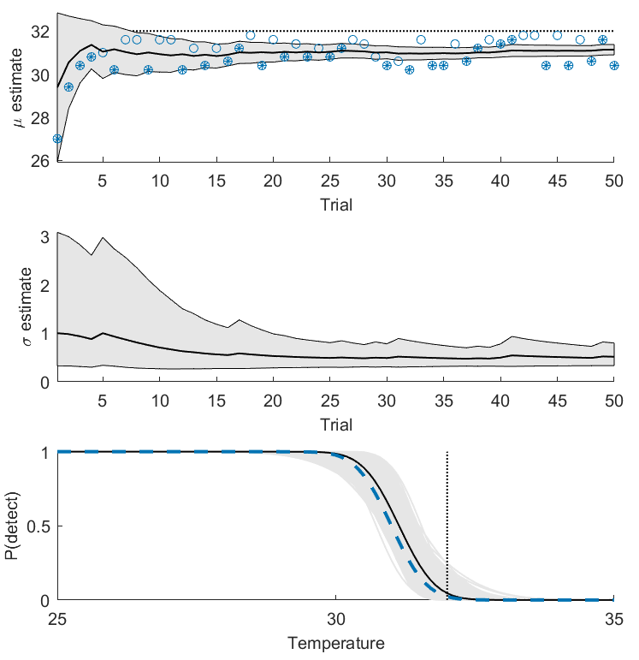
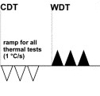
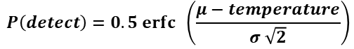
Two flavours of psychophysics
$$P\left(detect\right)=0.5 erfc \left(\frac{μ−temperature}{σ \sqrt{2}}\right)$$
Rolke et al., Eur J Pain (2006)

Slide 7
Types of psychophysical experiments
Experiments studying the participant’s reports on
The presence/absence of a stimulus (detection)
The difference between stimuli (discrimination)
The perceived intensity of a stimulus (scaling)

Slide 8
Types of psychophysical experiments
Experiments studying the participant’s reports on
The presence/absence of a stimulus (detection)
The difference between stimuli (discrimination)
The perceived intensity of a stimulus (scaling)

Slide 9
A naïve model of detection
Notes:
Why is this model naïve?

Slide 10
A naïve model of detection
Why is this model naive?
Notes:
Why is this model naïve?

Slide 11



We live in A noisy world…

Slide 12
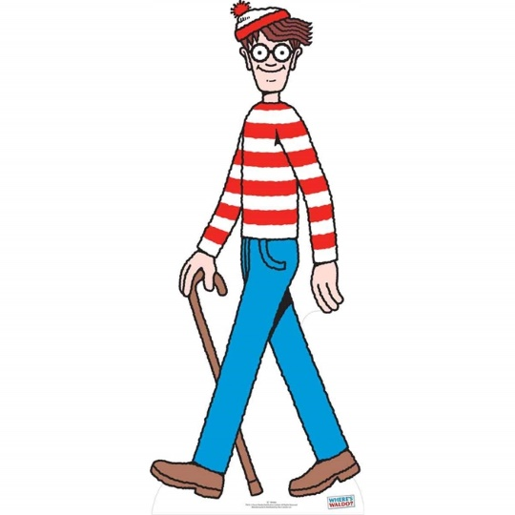
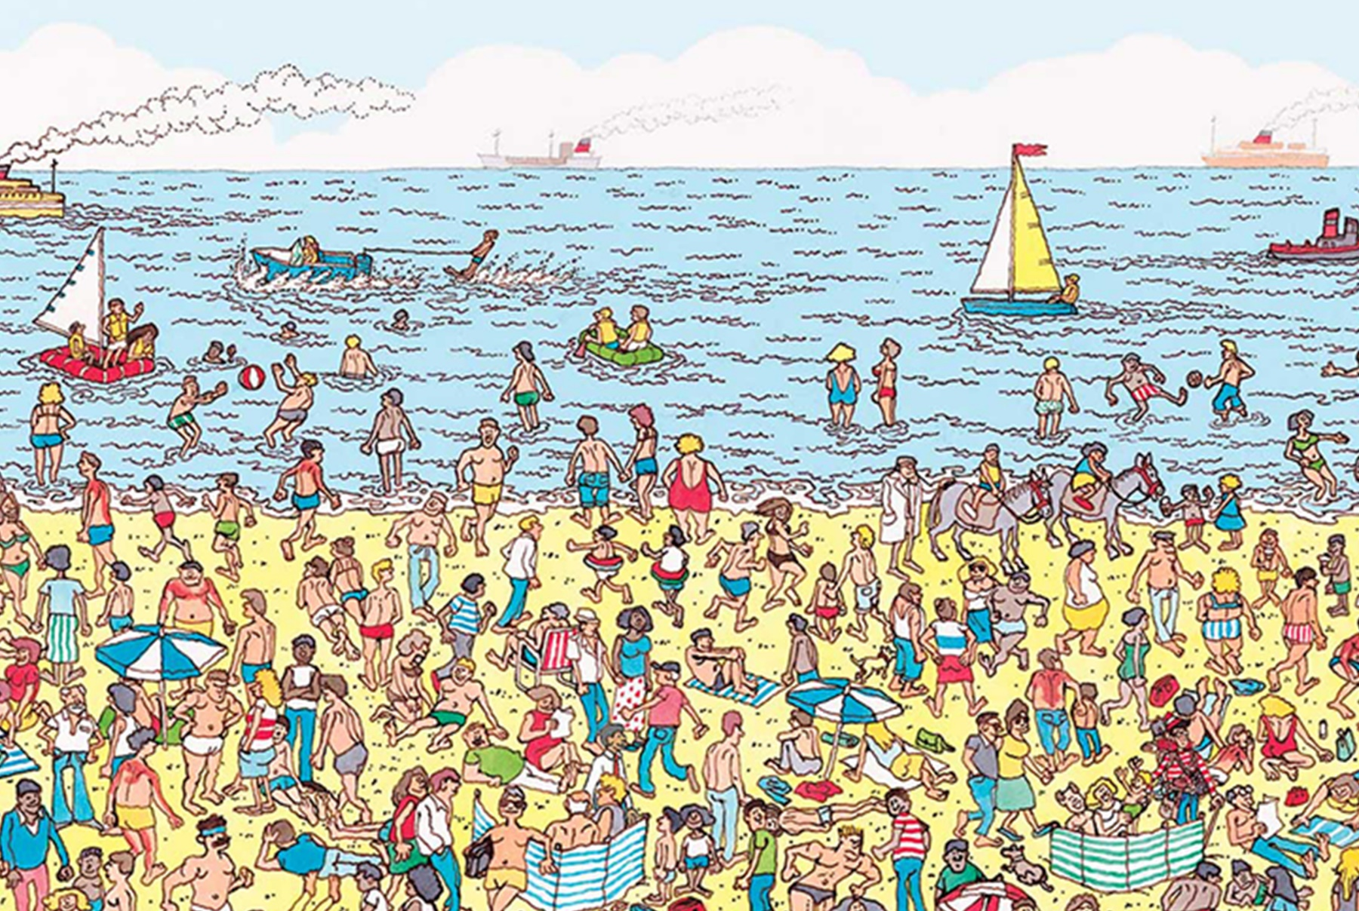
But we live in A noisy world…

Slide 13
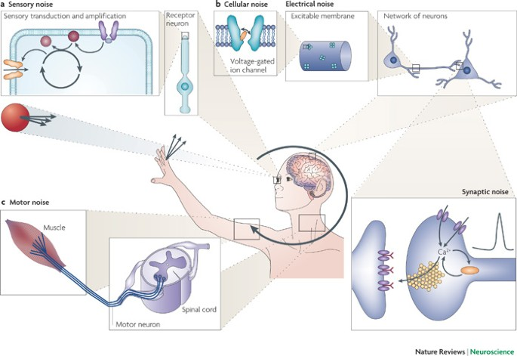
… That we sample with A noisy system
Faisal et al., Nat Rev Neuro (2008)

Slide 14
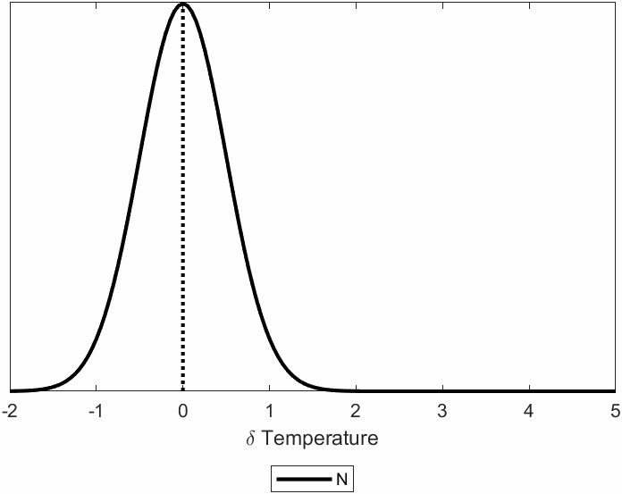
A better model of perception

Slide 15
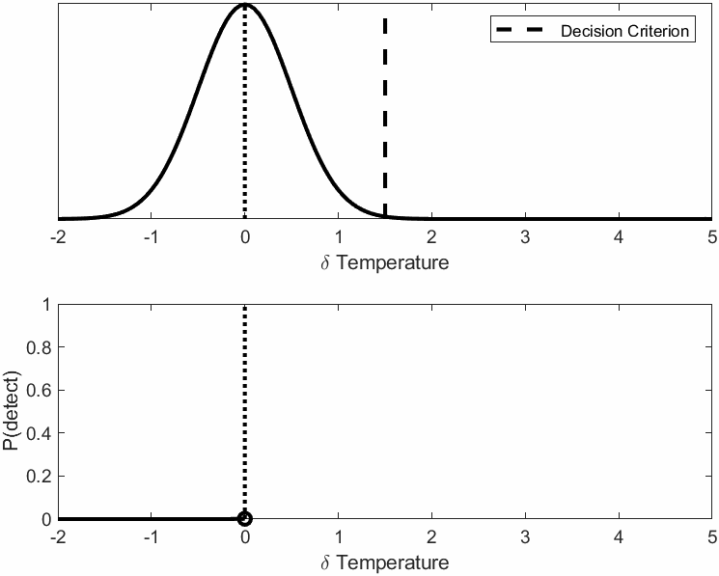
A better model of perception

Slide 16
Psychometric functions
$$Θ(x; α,β,γ,λ)=γ+\left(1−γ−λ\right)Φ(x;α,β)$$

Slide 17
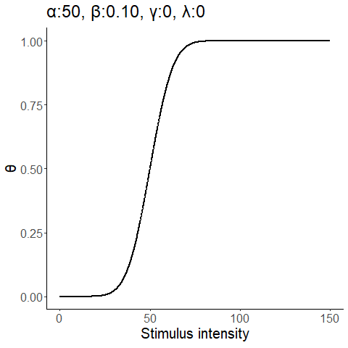
Psychometric functions
$$Θ(x; α,β,γ,λ)=γ+\left(1−γ−λ\right)Φ(x;α,β)$$

Slide 18
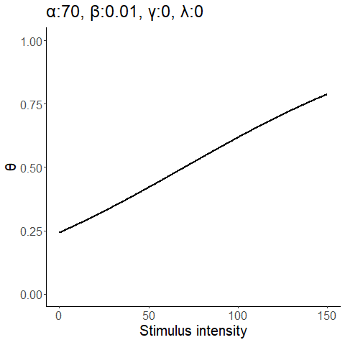
Psychometric functions
$$Θ(x; α,β,γ,λ)=γ+\left(1−γ−λ\right)Φ(x;α,β)$$

Slide 19
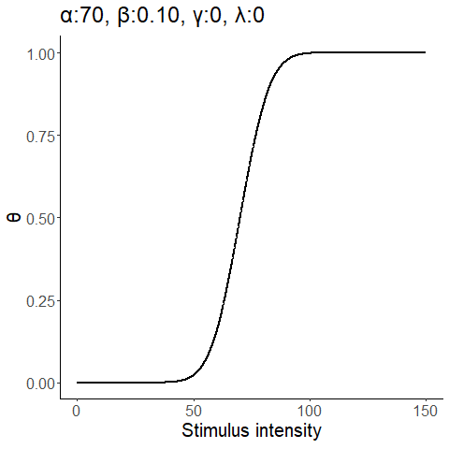
Psychometric functions
$$Θ(x; α,β,γ,λ)=γ+\left(1−γ−λ\right)Φ(x;α,β)$$

Slide 20
Psychometric functions
$$Θ(x; α,β,γ,λ)=γ+\left(1−γ−λ\right)Φ(x;α,β)$$

Slide 21
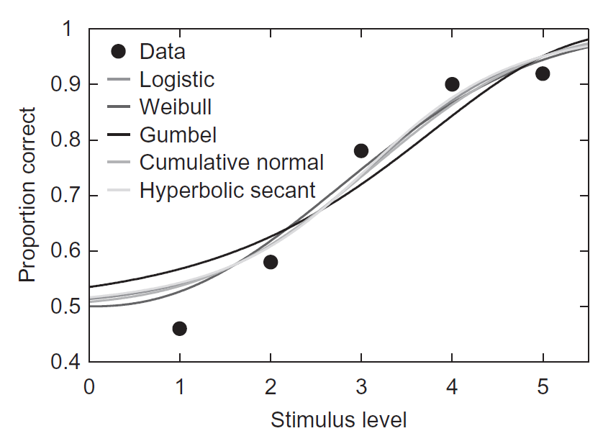
Psychometric functions
Kingdom & Prins, “Psychophysics: A Practical Introduction” (2010)
Notes:
What could explain different shapes?

Slide 22
Psychometric functions
What could explain differences in function shape?
Notes:
What could explain different shapes?

Slide 23
detection

Slide 24
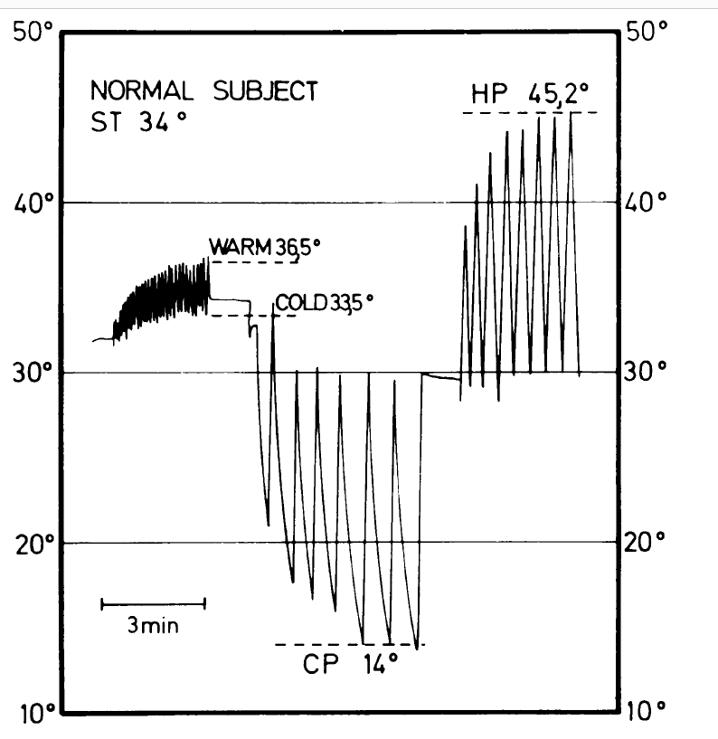
In practice – method of limits
Rolke et al., Eur J Pain (2006)
Fruhstorfer et al., JNNP (1976)

Slide 25
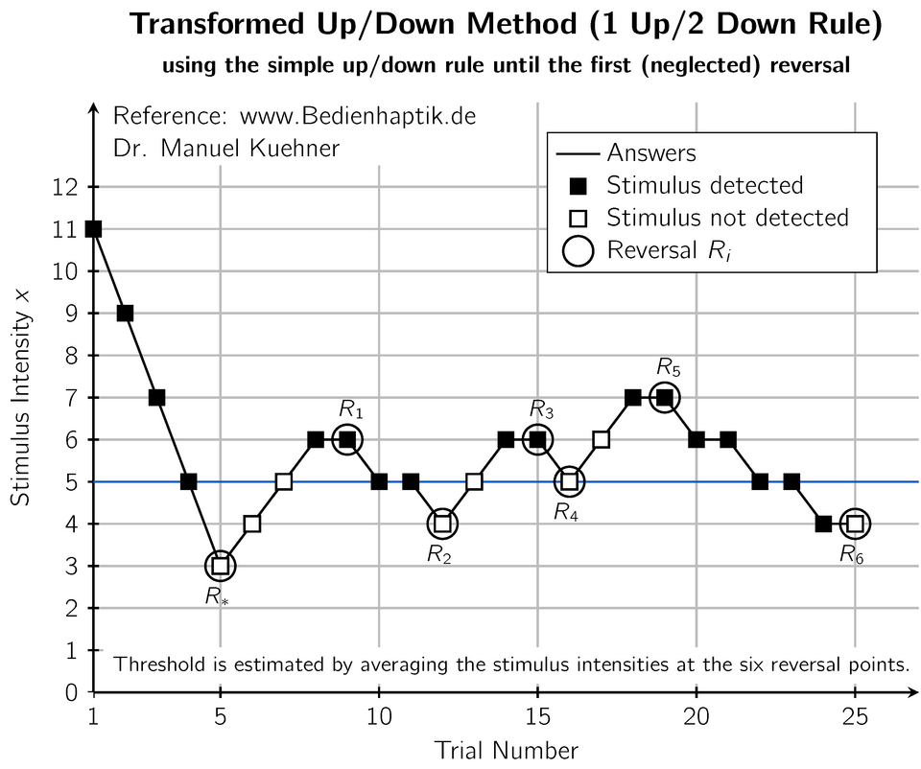
In practice – Up down staircase

Slide 26
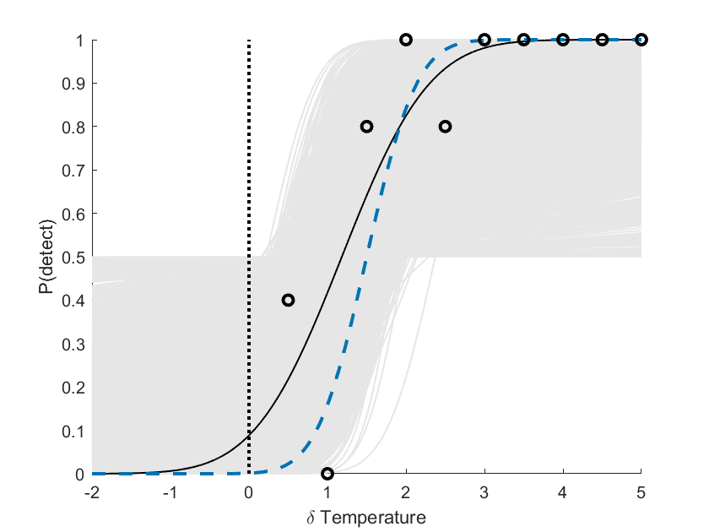
In practice – method of levels
5 trials / intensity
50 trials in total

Slide 27
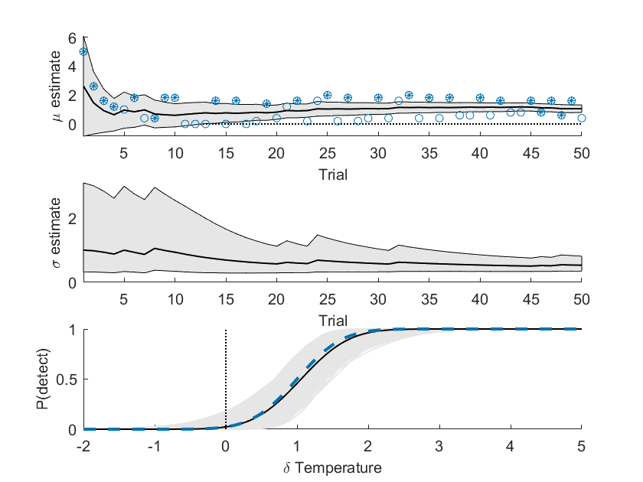
In practice–Adaptive method of levels
Psi method
(Bayesian adaptive algorithm)
50 trials in total

Slide 28
In practice–Adaptive method of levels
How would you decide where to place the next stimulus?

Slide 29
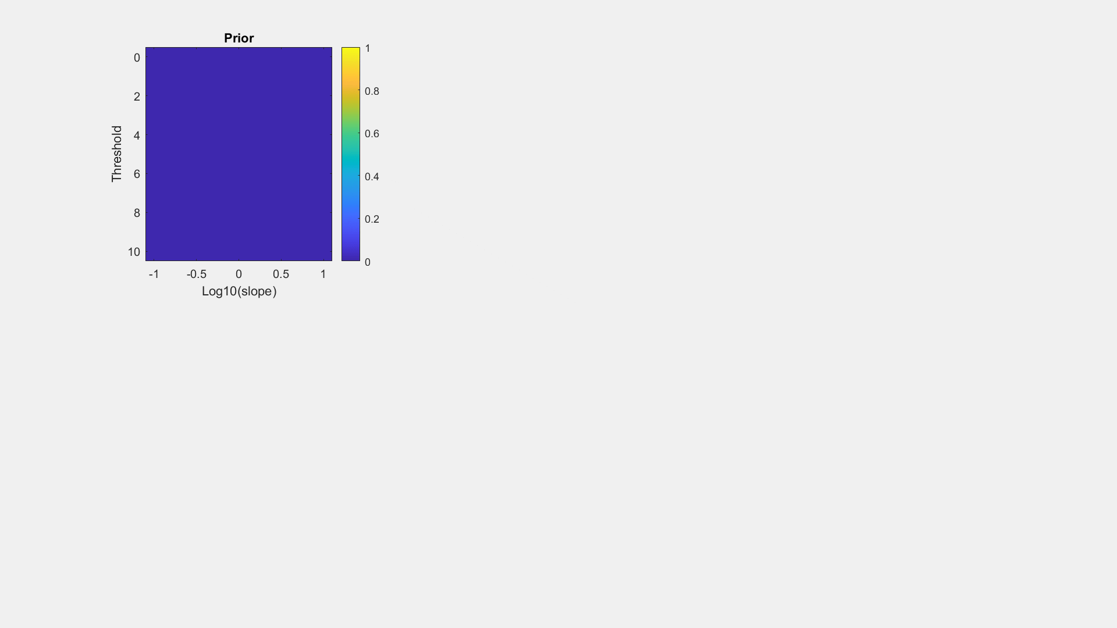
In practice – PSI method

Slide 30
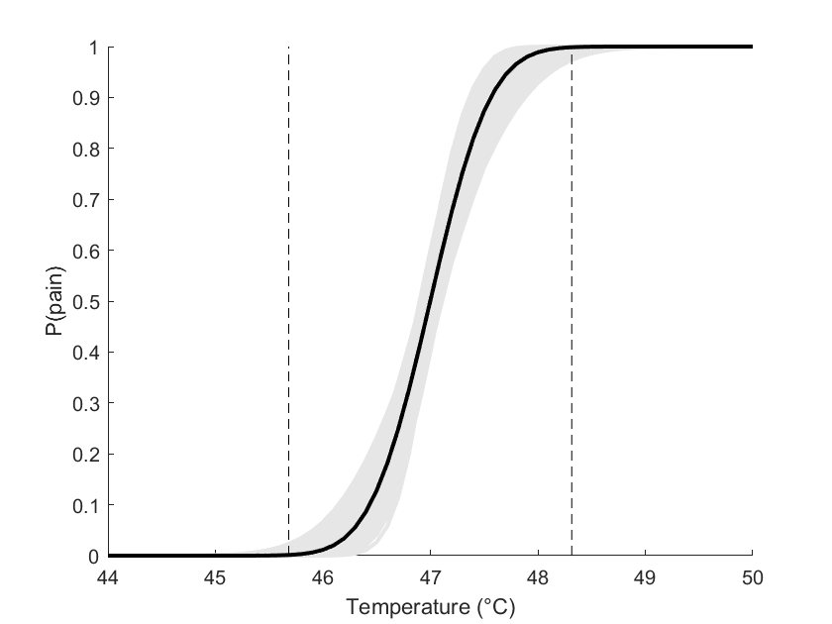
Example – Stimulus calibration
Courtin et al., in prep.

Slide 31
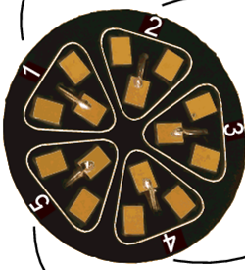
Example – Spatial summation
Courtin et al., Neurosci. Lett .(2023)

Slide 32
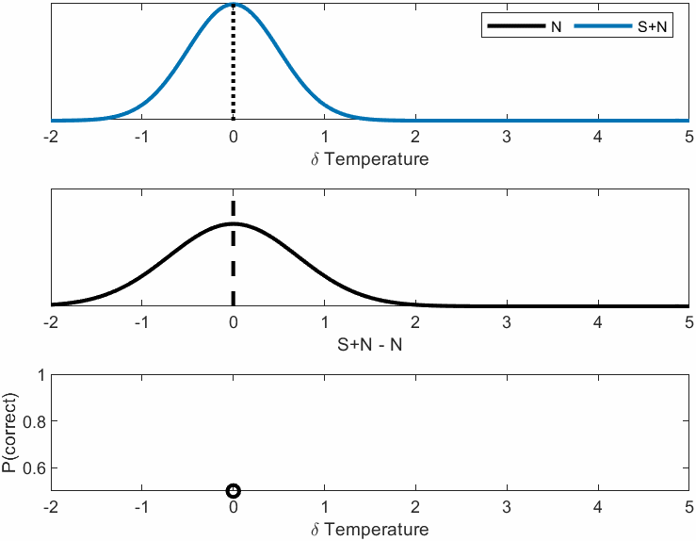
detection
2 Alternative/Interval Forced Choice

Slide 33
Psychometric functions
$$Θ(x; α,β,λ)=λ+\left(1−2λ\right)Φ(x;α,β)$$

Slide 34
Psychometric functions
$$Θ\left(x; α,β,λ\right).5+\left(.5−λ\right)Φ(x;α,β)$$

Slide 35
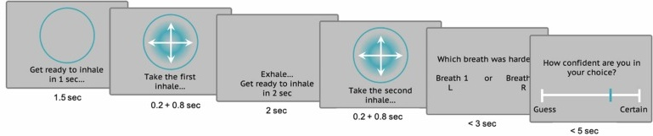
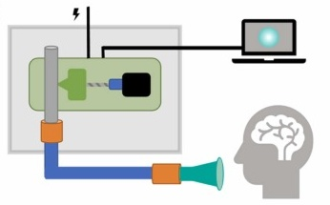
Example – Spatial summation
Nikolova et al., Biol Psych (2022).
Courtin et al., in prep.

Slide 36
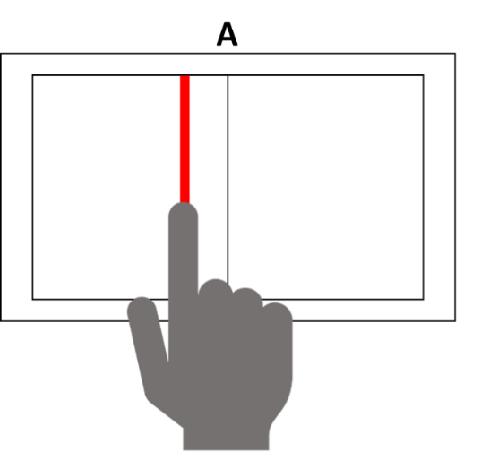
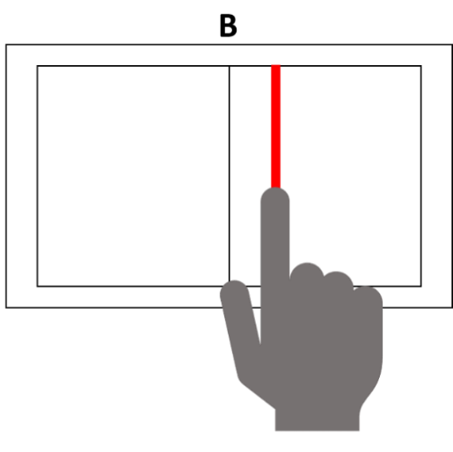
Example – Edge localisation
Esposito et al., under review

Slide 37
Types of psychophysical experiments
Experiments studying the participant’s reports on
The presence/absence of a stimulus (detection)
The difference between stimuli (discrimination)
The perceived intensity of a stimulus (scaling)

Slide 38
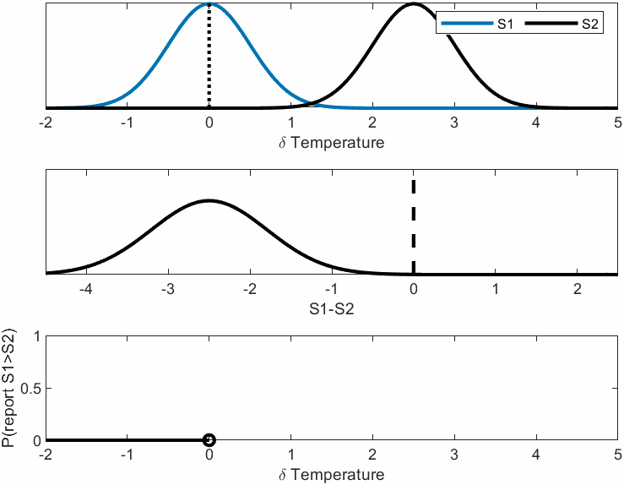
Discrimination

Slide 39
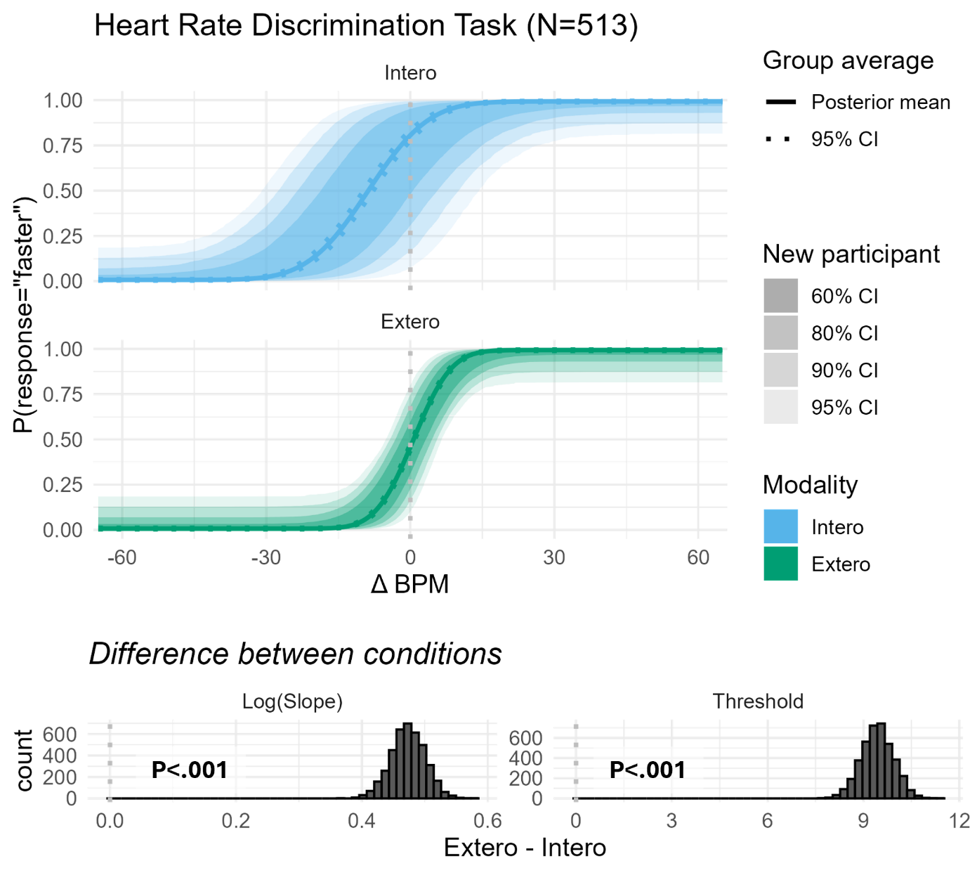
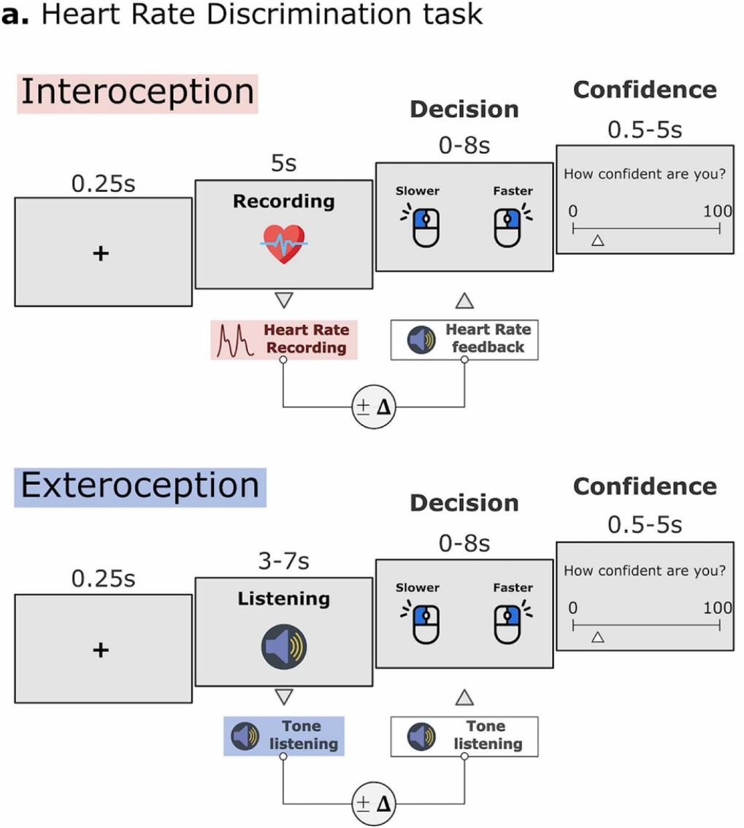
Example – Heart Rate discrimination
Legrand et al., Biol Psych (2022)
Courtin et al., in prep.

Slide 40
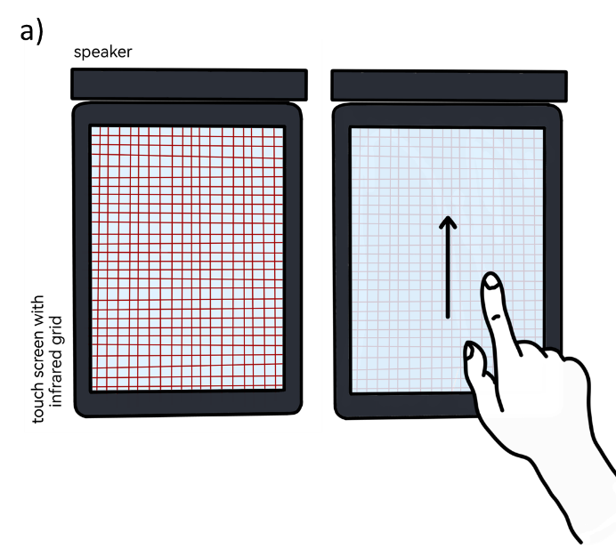
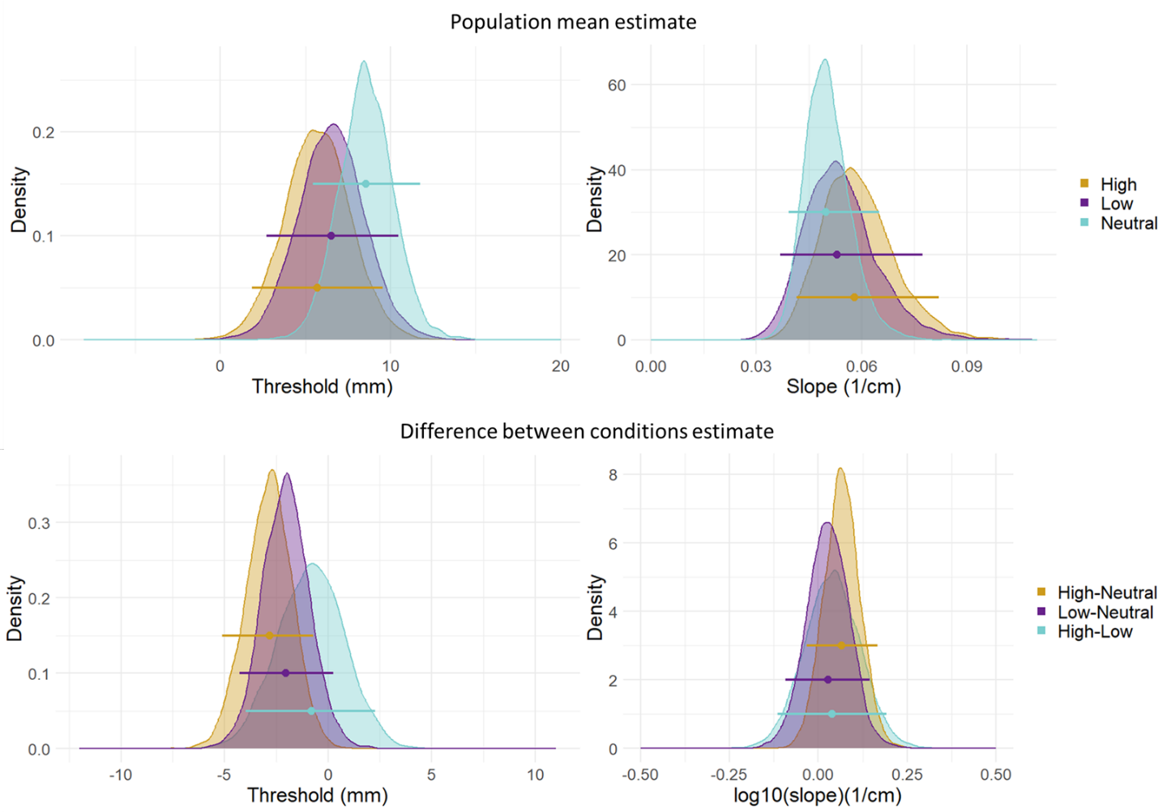
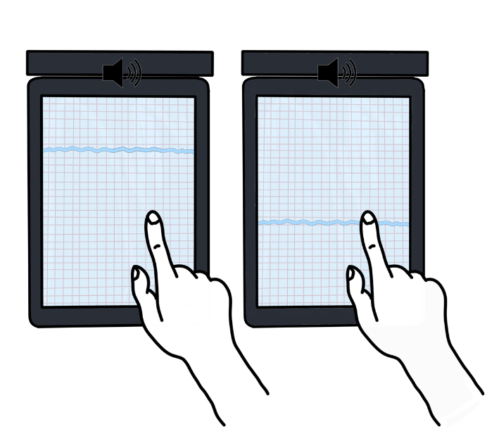
Example – Cross modal interaction
Casado-Palacios et al., in prep.

Slide 41
Types of psychophysical experiments
Experiments studying the participant’s reports on
The presence/absence of a stimulus (detection)
The difference between stimuli (discrimination)
The perceived intensity of a stimulus (scaling)

Slide 42
Scaling

Slide 43
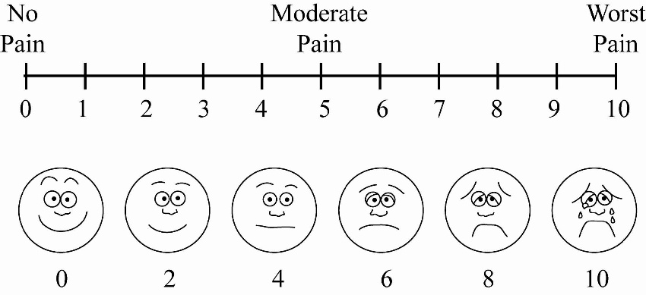
Magnitude estimation
Numerical Rating Scale
“On a scale from 0 to 100, 0 being no sensation and 100 the most intense sensation you can imagine, how intense was the stimulus?”

Slide 44
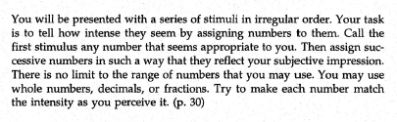
Magnitude estimation
Visual Analog Scale
Open ended numerical scale
Not detected
Most intense
Gescheider (1997)

Slide 45
Forced choice task

Slide 46
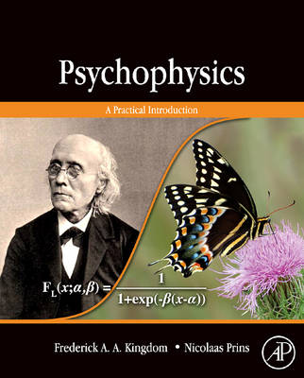
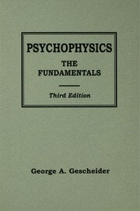
Ressources

Slide 47
References
Courtin AS, Delvaux A, Dufour A, Mouraux A. Spatial summation of cold and warm detection: Evidence for increased precision when brisk stimuli are delivered over larger area. Neurosci Lett 2023;797:137050.
Faisal AA, Selen LPJ, Wolpert DM. Noise in the nervous system. Nat Rev Neurosci 2008;9:292–303.
Fruhstorfer H, Lindblom U, Schmidt WC. Method for quantitative estimation of thermal thresholds in patients. J Neurol Neurosurg Psychiatry 1976;39:1071–5.
Legrand N, Nikolova N, Correa C, Brændholt M, Stuckert A, Kildahl N, Vejlø M, Fardo F, Allen M. The heart rate discrimination task: A psychophysical method to estimate the accuracy and precision of interoceptive beliefs. Biol Psychol 2022;168:108239.
Nikolova N, Harrison O, Toohey S, Brændholt M, Legrand N, Correa C, Vejlø M, Jensen MS, Fardo F, Allen M. The respiratory resistance sensitivity task: An automated method for quantifying respiratory interoception and metacognition. Biol Psychol 2022;170:108325.
Rolke R, Baron R, Maier C, Tolle TR, Treede RD, Beyer A, Binder A, Birbaumer N, Birklein F, Botefur IC, Braune S, Flor H, Huge V, Klug R, Landwehrmeyer GB, Magerl W, Maihofner C, Rolko C, Schaub C, Scherens A, Sprenger T, Valet M, Wasserka B. Quantitative sensory testing in the German Research Network on Neuropathic Pain (DFNS): standardized protocol and reference values. Pain 2006;123:231–43.

Slide 48
Hierarchical models
$$Θ(x; α,β,λ)=λ+\left(1−2λ\right)Φ(x;α,β)$$
Notes:
Talked a lot about these psychometric functions in a vaccum. But what about when we do experiments? Multiple subjects etc.. Hierarchical models!

Slide 49
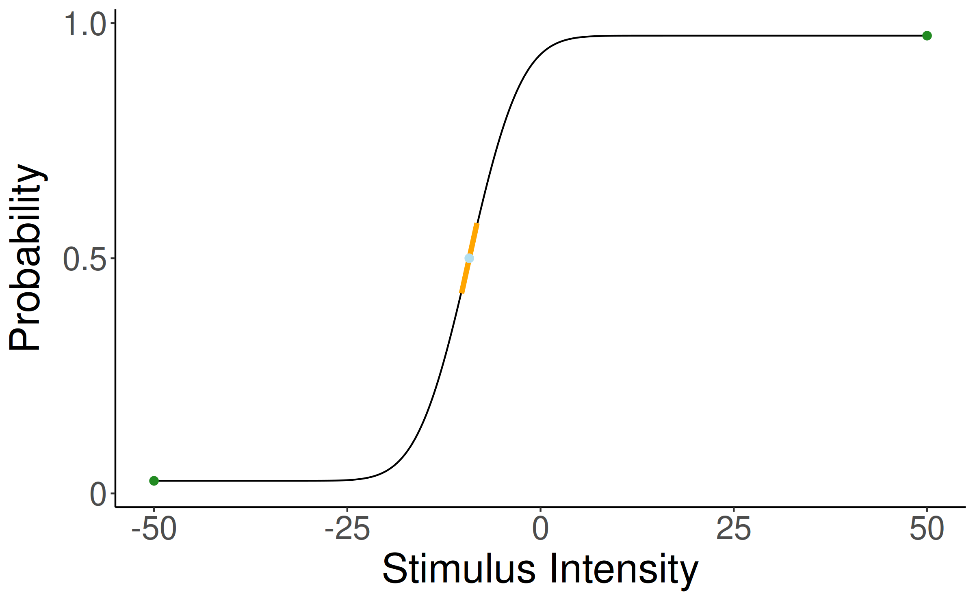
Hierarchical models
Notes:
Here I show how some subjects might look when plotting their infered psychometric function with the equation laid out for them all.
This is similar to linear mixed effects modeling blablblalba.
Thus we get:

Slide 50
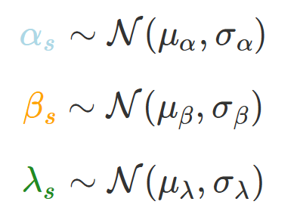
Hierarchical models
Notes:
So visually this means we have a "group level psychometric" with mu alpha blablalba

Slide 51
Hierarchical models
Notes:
Here we get the subject level parameters from and sigma_alpha is thus the between subject varability.
How does this look in stan?

Slide 52
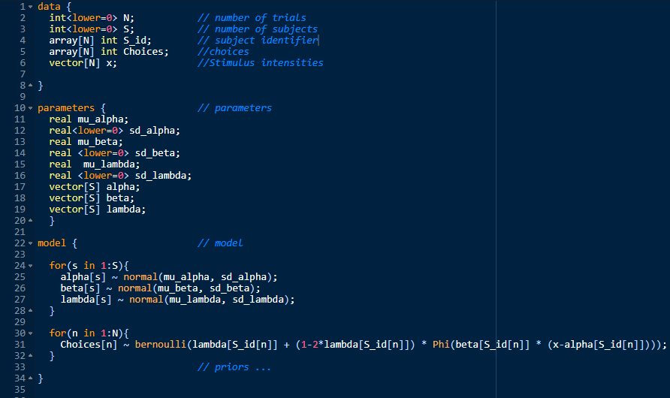
Hierarchical models
Notes:
This is for demonstration proposes only! if you try to code this up it won't run for two particular reasons, one simpler than the other, does any have an idea of why? (outside of the priors missing)
Priors
Constraints
Parameterization.

Slide 53
Hierarchical models
Notes:
As Arthur alluded to we do a lot of these psychometric models across modains. Thermosensation, Interoception decision making etc. For one of the paradigms we wanted to investigate what the hierarchical fitting actually benefits in terms of being able to find differences in a within subject experimental paradigm. (placebo vs drug).
So we simulated a lot experiments with differening amount of trials subjects and differences between conditions (cohens d effect size).
To see how these experimental variables influence power of detecting the effect!
We fitted some Stan to both the estimates taking directly from PSI and collected those estimated from a hierarchical model where one assumes that the subject level estimates comes directly from the hierarchical model.
First we investigated the threshold

Slide 54
Hierarchical models
Notes:
Here we see the threshold estimates.
Fill = power for the hierachical model. Lines are the required subjects, trials and effect size to achieve 80% power for each of the fitting types.
And then the slope

Slide 55
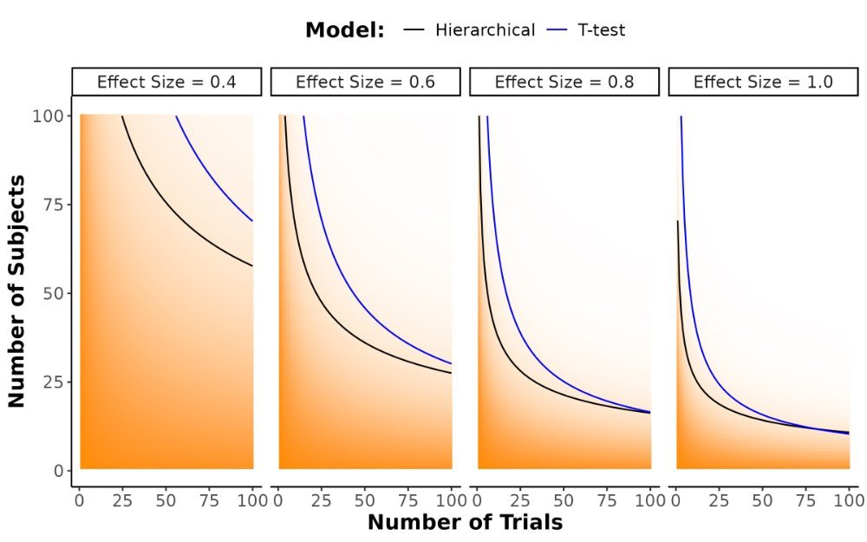

Hierarchical models
Notes:
The slope estimates.

Slide 56
Multi-variate models
Notes:
Okay so now I want to shift gears a little bit and talk about something that I have been interested in and working on for some time and that iis
Multivariate models.
So what is the difference between the models we've looked at and multivariate models or multi-variable models?
The problem here, or the opportunity lost, is that when we collect binary response we also collect response times!
These RT's should be able to also tell us something about the underlying process and ideally also be included in our analyses and models!
So lets look at one experiment where they collected binary responses and response times

Slide 57
Multi-variate models
Bang et al., G. J. Exp. Psychol (2019)
Notes:
So what we see here is aggregated data across trial and subjects (thus the group level) for a decision making task. The task itself I won't go into, but the data and the relationship is something you see in most decision making task where the binary responses can be nicely modeled with a psychometric function.
You see a similar pattern in learning experiments. What this shows is that when people are getting a stimulus that is more easily recognizeable they also respond quicker and when the stimulus is harder to recognize (or predict in learning) then people respond slower.
How might we model this?

Slide 58
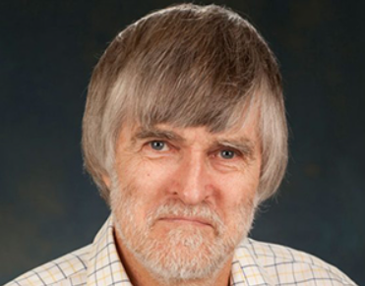
Drift diffusion model
Roger Ratcliff
(1947-now)
Notes:
The drift diffusion model was proposed and laid out by Roger Ratcliff. Which draws a lot of inspriation from brownian motion.

Slide 59

Drift diffusion model
Notes:
The different diffusion model assumes that a subjects evidence (x) evovles in time t as stocastic differential equation (dt as the standard deviation of the normal) with a tendency (drift rate v).

Slide 60
Drift diffusion model
Notes:
One can take it in discrete steps which makes it easier to work with.

Slide 61
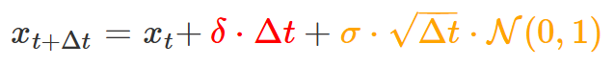
Drift diffusion model
Notes:
Now one can show that the red is the mean of a normal and the yellow is a dispersion of the distribution. I.e.

Slide 62
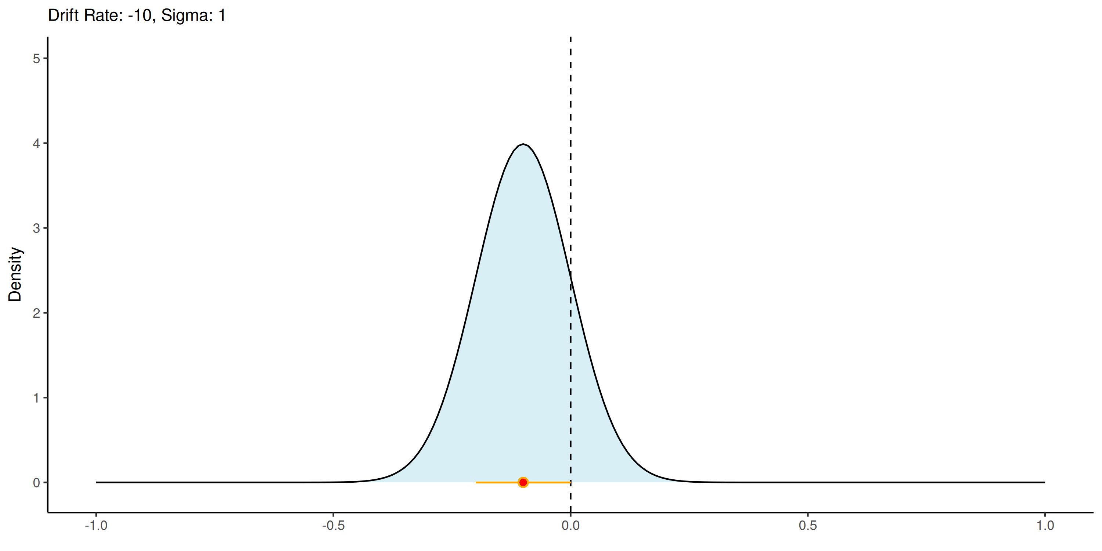
Drift diffusion model

Slide 63
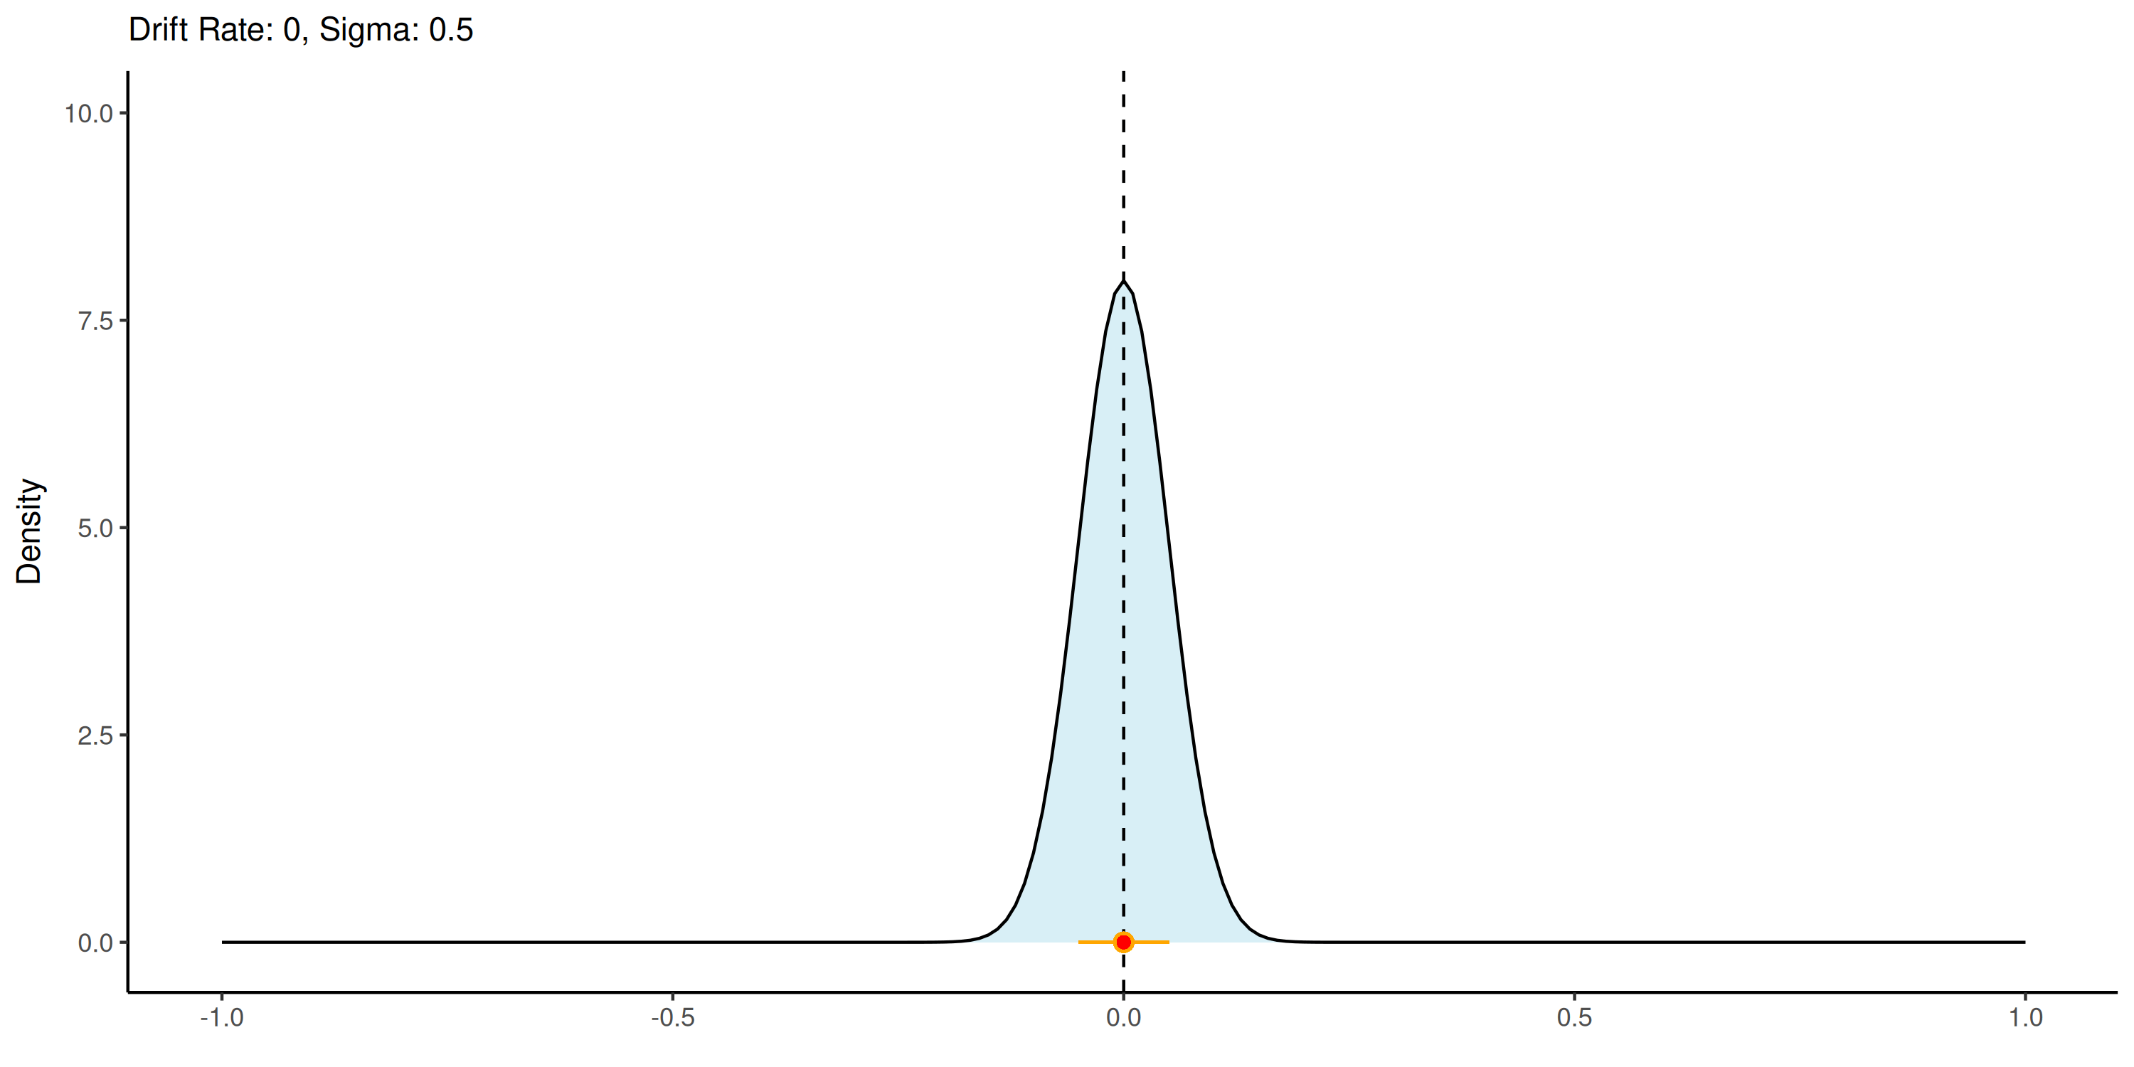
Drift diffusion model
Notes:
These two parameters thus help determine what the size and direction the evidence (x) moves as a function of time. These are the two first parameters of the DDM

Slide 64
Drift diffusion model
Notes:
The probability distribution of the DDM itself follows something that is a bit more complicated that introduced 3 other parameters, alpha, tau and beta. Lets go through these 1 step at a time.
To introduce these we have to look at the "space" where the evidence is accumulated.
We have that the particle moves in 2 dem. across time (x) and up or down.

Slide 65
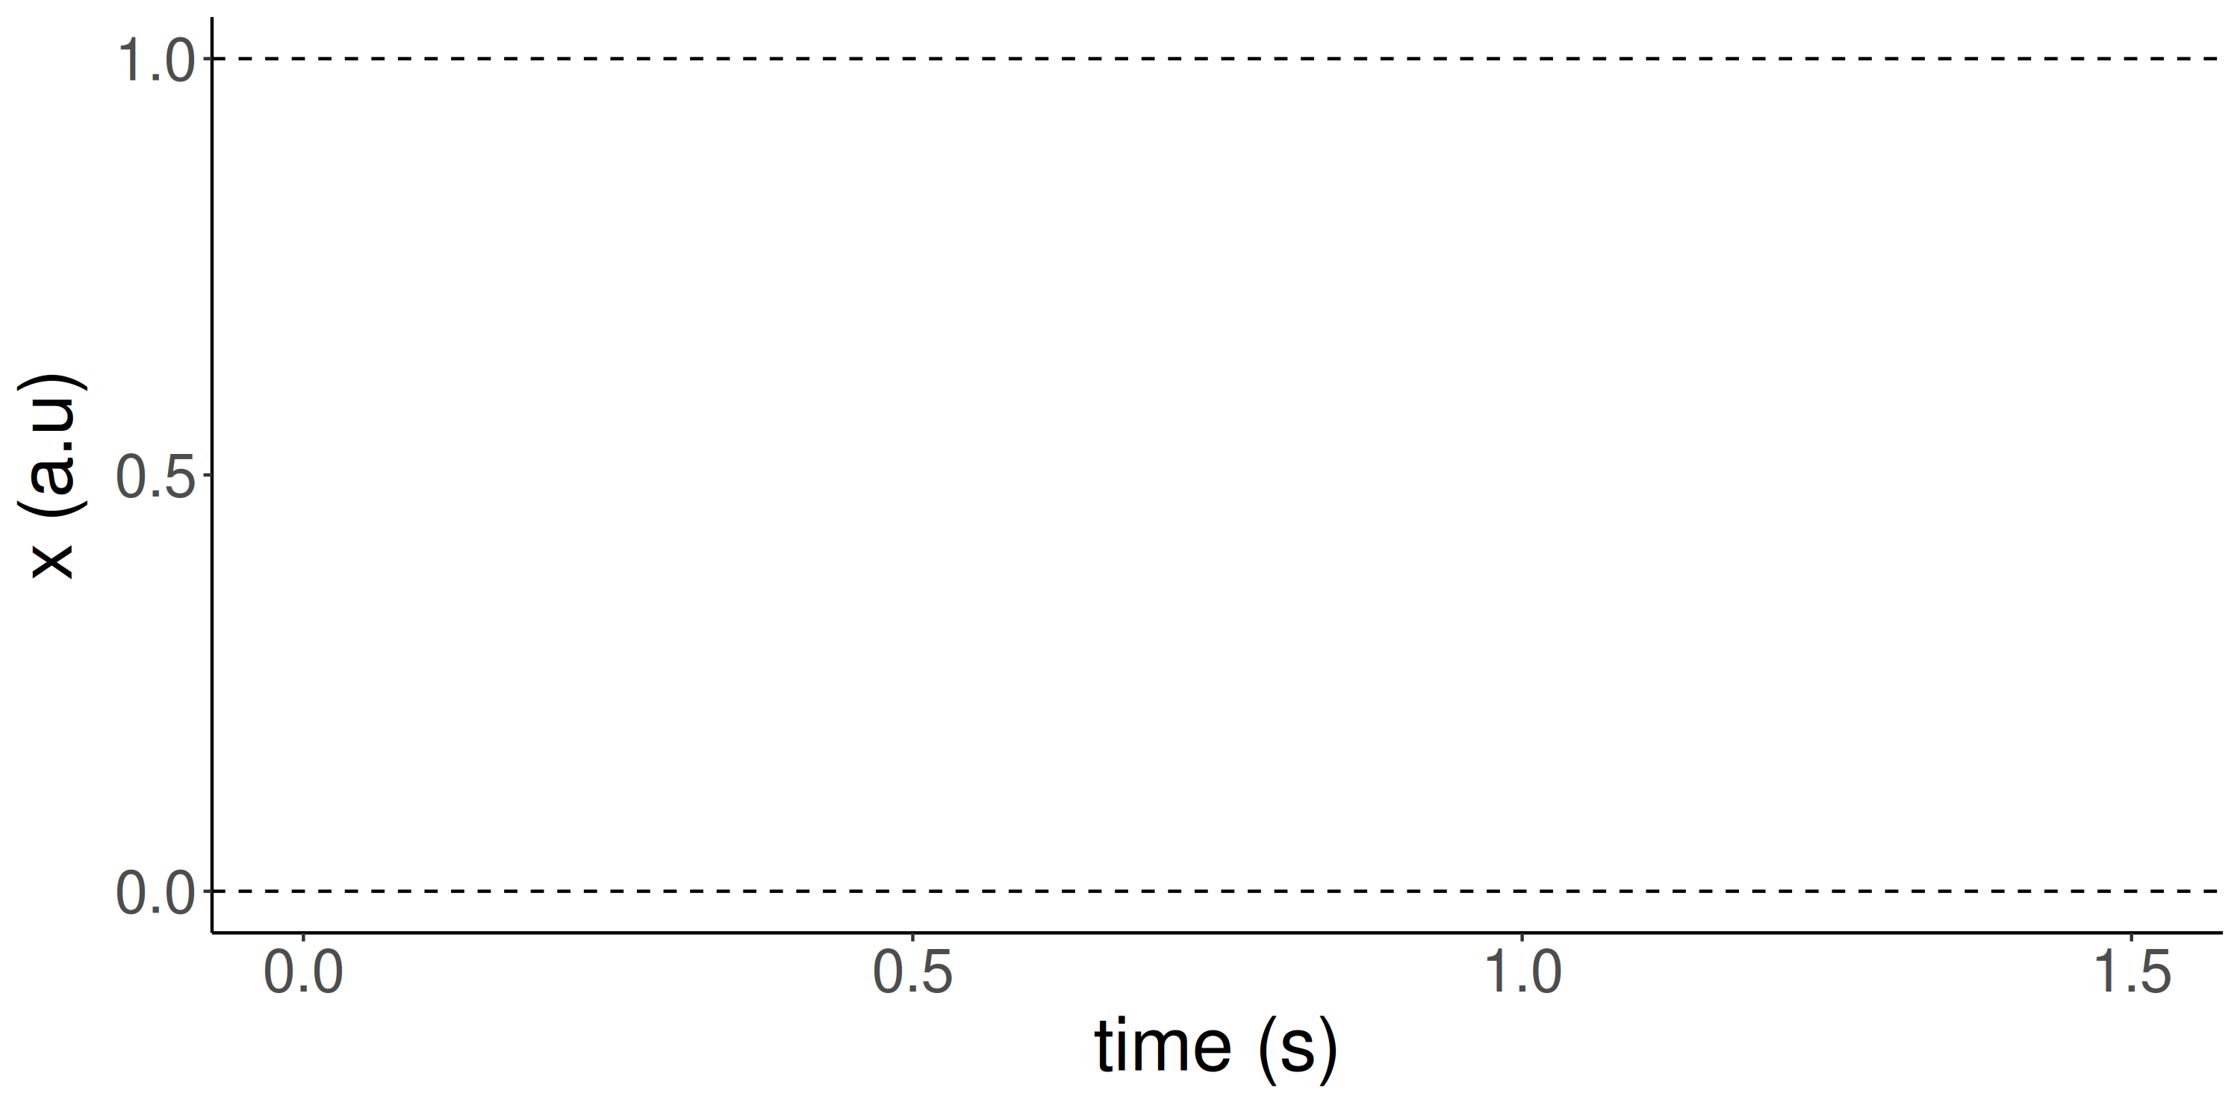
Drift diffusion model

Slide 66
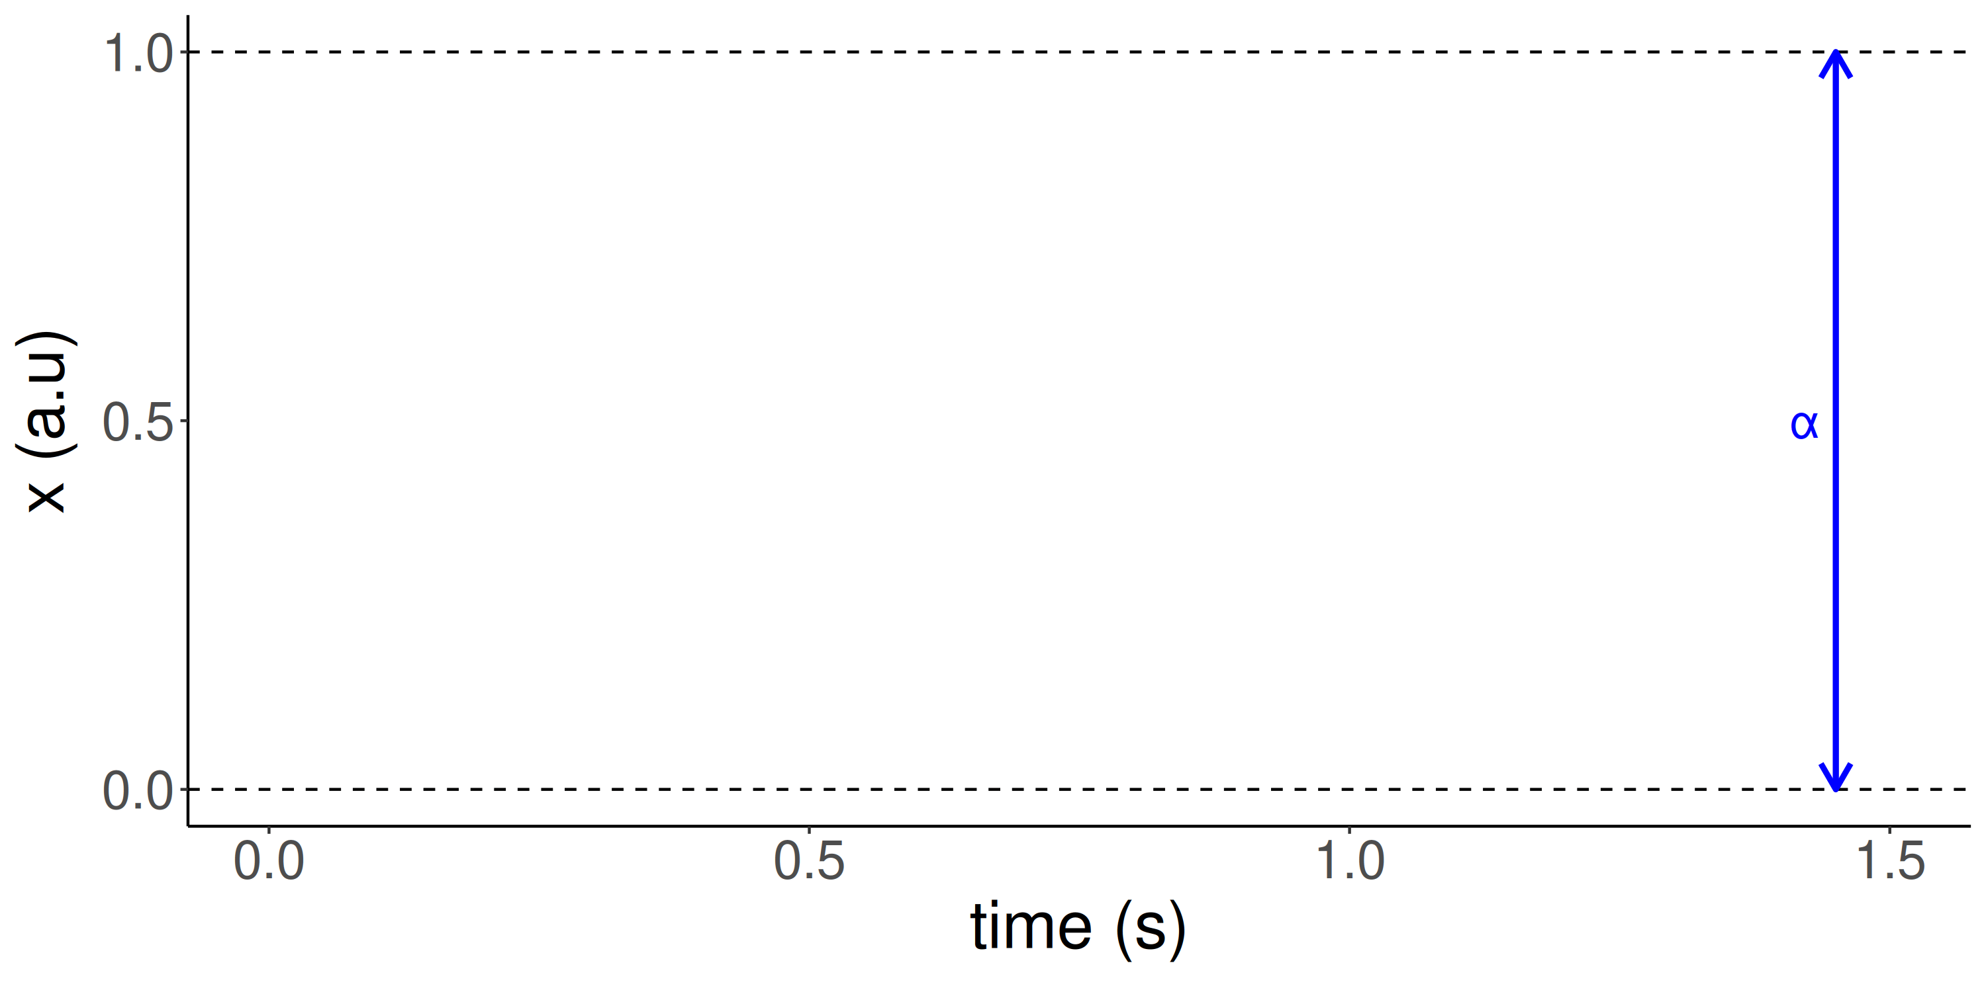
Drift diffusion model

Slide 67
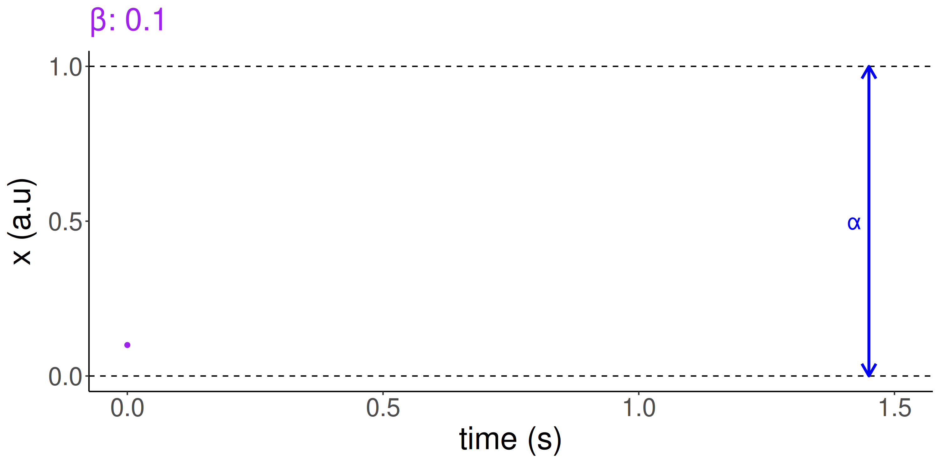
Drift diffusion model

Slide 68
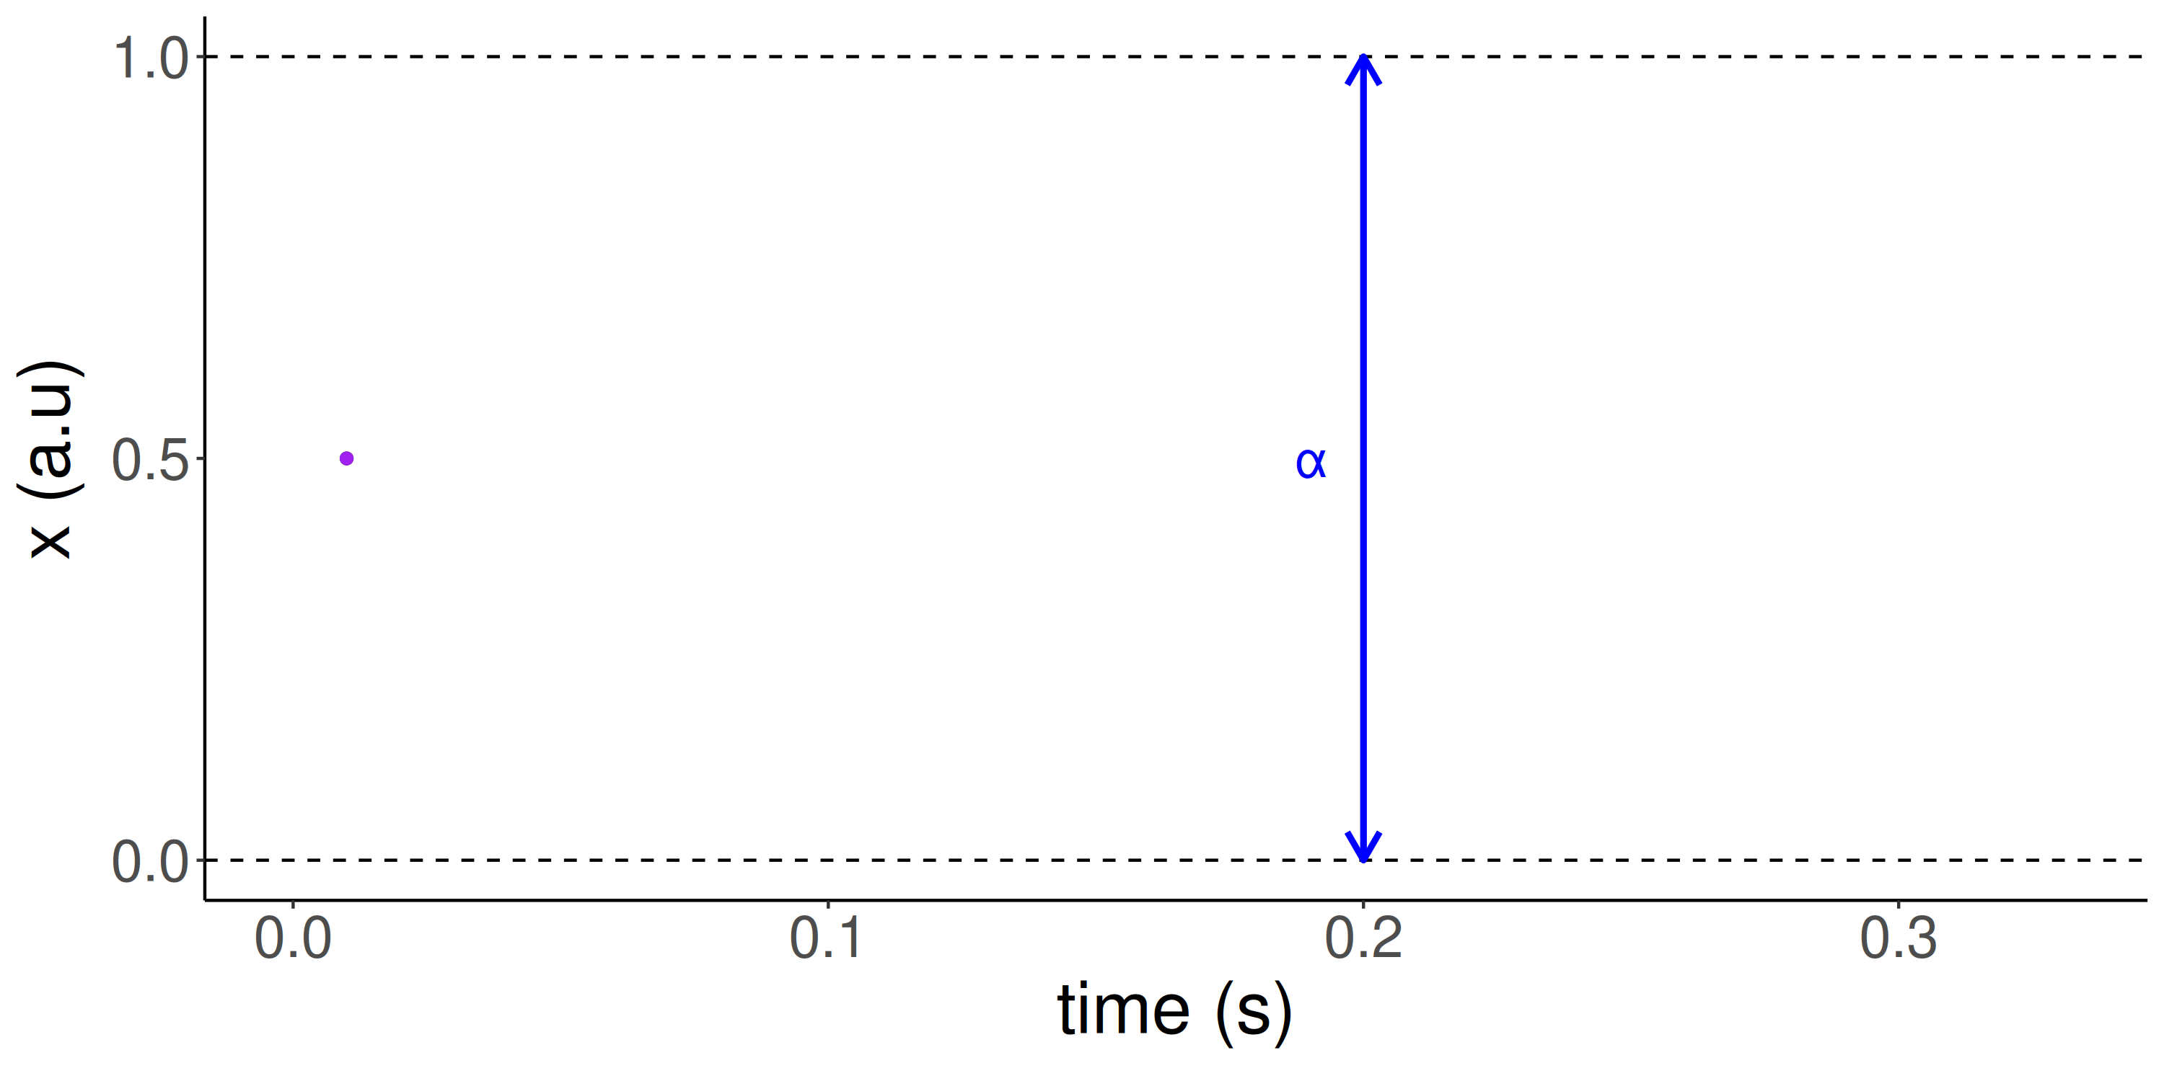

Drift diffusion model
Notes:
What I haven't talked about is the tau (green thing in the equation) this is essentially not to interesting as its just a verical shift in when evidence starts to be accumulated. Thus if we shift the x-axis to the left such that 0 is now 0.2 we would have a tau = 0.2.

Slide 69

Drift diffusion model
Notes:
A couple together:

Slide 70




Notes:
A lot that then produces response time histograms and binary responses to the right

Slide 71

Drift diffusion model
Notes:
How it looks in STAN: Not to bad.

Slide 72
Drift diffusion model
Notes:
So this was what I started with to be explained. How does the DDM do on this? Here there are some extra assumptions that I jump over. As in how is the DDM related to the stimulus intensity? And so on.
We need to assume how the DDM is related to the stimulus intensity.

Slide 73
Drift diffusion model
Notes:
Decently not peferctly.
But what if you are not sure about the assumption of evidence accumulation or don't want to assume it?
Or perhaps you think you have such a nice model for the binary responses and want something similar for the RTs what might you do?

Slide 74




Chronometric functions
-
-
Piéron's Law (1914)
Bonnet et al (2008)
Palmer & Stone (2014 & 2021)
Entropy (Hick & Hyman & Grossman
1952 & 1953 & 1953))
Notes:
Well we have a nice model for the binary ratings, what about purely response time models? Chonometric functions. We actually have quite some litterature on this:
Pierons (at x = 0 rt(x) = inf)
Bonnet: log odds (logit) of the probabilities. At the extreme p -> 1 RT -> - inf p -> 0 RT -> inf
Palmer & Stone model is based on both the stimulus intensity and the probability and produces something sensiable but is build from the DDM assumptions.
Then we have the entropy

Slide 75


Multi-variate models
William Edmund Hick
(1912-1974)
Ray Hyman
(1929-now)

Slide 76

Multi-variate models
Notes:
Both Hyman and Hick picked up on a study and idea laid forth by a german named julius Merkel from 1885 who studied human reaction time of 10 different stimuli (as many as we have fingers). Subjects then got a visual indication of what to respond.
He manipulated the number of options and observed the difference in response time to these.
What Merkel did not claim back then was the particular type of relationship. But that was changed by hick and Hyman (prob. due partly to the excitment about shannon's contribution to communication and information).
"Shannon developed information entropy as a measure of the information content in a message, which is a measure of uncertainty reduced by the message"

Slide 77

Multi-variate models
Hick., Q. J. Exp. Psychol. (1952).
Notes:
Here we see what hick found also compared to what merkel found.
That as people have more choices that can be made they respond slower but logarithmically.

Slide 78

Multi-variate models
Hyman., Q. J. Exp. Psychol. (1953)
Notes:
Hymann showed the same thing, that as people have more choices that can be made they respond slower but logarithmically.
He just plotted it as the entropy and thus the line becomes linear.
Thus people get slower with more options this can be framed as becoming linearly slower with the entropy of the stimulus (higher number stimuli gives higher entropy).
If these stimuli have the same probability the relationship between entropy and number of stimuli is H = log(n).

Slide 79

Multi-variate models
Grossman., Q. J. Exp. Psychol. (1953)
Notes:
Grossman in the same two years wanted to extend the findings og hyman and hick to cases where there wasn't equal probability.
He did this with playing cards.
He asked his subjects to pick one card at a time and then (given some goal) to sort the cards.

Slide 80

Multi-variate models
Grossman., Q. J. Exp. Psychol. (1953)
Notes:
With this he could for instance say sort it to black and red (equal probabilities with 2 choices) or perhaps into pictures vs non-pictures (non-equal probabilities with 2 choices).

Slide 81

Multi-variate models
Grossman., Q. J. Exp. Psychol. (1953)
Notes:
He found that the time per card i.e. the response time was linearly related to the entropy per card.
So what does this mean?
It means that the entropy equations seems to hold also for probabilities that are different from one another.
We can use this as the psychometric function produces the probability that the subject will respond (either 0 or 1) and thus use it in our equation.

Slide 82
Multi-variate models
Notes:
So we had this:

Slide 83
Multi-variate models
Notes:
This is the psychometric fucntion and the entropy function on the response times that are influenced by the psychometric:

Slide 84

Multi-variate models
Notes:
This looks like this in stan:
Look at the two likelihood statements:

Slide 85
Multi-variate models
Notes:
The two overlaid.

Slide 86
References
Bang, J. W., Shekhar, M., & Rahnev, D. (2019). Sensory noise increases metacognitive efficiency. Journal of Experimental Psychology: General, 148(3), 437–452. https://doi.org/10.1037/xge0000511
Crossman, E. R. F. W. (1953). Entropy and Choice Time: The Effect of Frequency Unbalance on Choice-Response. Quarterly Journal of Experimental Psychology, 5(2), 41–51. https://doi.org/10.1080/17470215308416625
Hick, W. E. (1952). On the Rate of Gain of Information. Quarterly Journal of Experimental Psychology, 4(1), 11–26. https://doi.org/10.1080/17470215208416600
Hyman, R. (1953). Stimulus information as a determinant of reaction time. Journal of Experimental Psychology, 45(3), 188–196. https://doi.org/10.1037/h0056940

Slide 88
Practical exercises
Simulate data from psychophysical experiment
Write psychometric function stan programs
Pathfinder (experimental design optimization)
DDM multivariate modeling
Entropy-based multivariate modeling
https://github.com/JesperFischer/Cognitive-Science-Exercises

